Slide 1
Multimedia: Making it Work
Chapter 06
Images

Slide 2
Images
Creation of multimedia images.
Creation of still images.
Colors and palettes in multimedia.
Image file types used in multimedia

Slide 3
Creation of Multimedia Images
Before commencing the creation of images in Multimedia, one should:
    Plan their approach using flow charts and storyboards.
    Organize the available tools.
    Have multiple monitors, if possible, for lots of screen real estate.

Slide 4
Creation of Still Images
Still images may be the most important element of a multimedia project.
The type of still images created depends on the display resolution, and hardware and software capabilities.

Slide 5
Still Images
Still images are generated in two ways:
  Bitmaps.
    Bitmaps are used for photo-realistic images and for complex drawings requiring fine detail.
  Vector-drawn graphics
    Vector-drawn objects are used for lines, boxes, circles, polygons, and other graphic shapes that can be mathematically expressed in angles, coordinates, and distances.

Slide 6
Still Images
A drawn object can be filled with color and patterns, and you can select it as a single object. The appearance of both types of images depends on the display resolution and capabilities of your computer’s graphics hardware and monitor.

Slide 7
Still Images
Both types of images are stored in various file formats and can be translated from one application to another or from one computer platform to another.
Typically, image files are compressed to save memory and disk space; many bitmap image file formats already use compression within the file itself—for example, GIF, JPEG, and PNG.

Slide 8
Still Images
Bitmaps
  A bit is the simplest element in the digital world, an electronic digit that is either on or off, black or white, or true (1) or false (0).
  This is referred to as binary, since only two states (on or off) are available.
  A map is a two dimensional matrix of these bits. A bitmap, then, is a simple matrix of the tiny dots that form an image and are displayed on a computer screen or printed.

Slide 9
Bitmaps
Bitmap is derived from the words ‘bit’, which means the simplest element in which only two digits are used, and ‘map’, which is a two-dimensional matrix of these bits.
A bitmap is a data matrix describing the individual dots of an image.

Slide 10
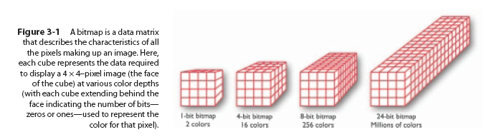
Bitmaps
A one-dimensional matrix (1-bit depth) is used to display monochrome images—a bitmap where each bit is most commonly set to black or white. Depending upon your software, any two colors that represent the on and off (1 or 0) states may be used. More information is required to describe shades of gray or the more than 16 million colors that each picture element might have in a color image, as illustrated in Figure 3-1.

Slide 11
Bitmaps
These picture elements (known as pels or, more commonly, pixels) can be either on or off, as in the 1-bit bitmap, or, by using more bits to describe them, can represent varying shades of color (4 bits for 16 colors; 8 bits for 256 colors; 15 bits for 32,768 colors; 16 bits for 65,536 colors; 24 bits for 16,772,216 colors).

Slide 12
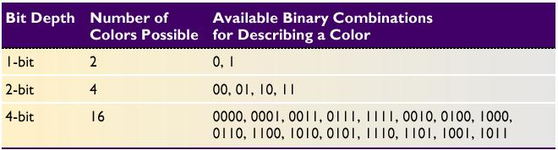
Bitmaps
Thus, with 2 bits, for example, the available zeros and ones can be combined in only four possible ways and can, then, describe only four possible colors:
Available binary Combinations for Describing a Color

Slide 13
Bitmaps
Bitmaps are an image format suited for creation of:
  Photo-realistic images.
  Complex drawings.
  Images that require fine detail.

Slide 14
Bitmaps
Bitmapped images are known as paint graphics.
A bitmap is made up of individual dots or picture elements known as pixels or pels.
Bitmapped images can have varying bit and color depths.

Slide 15
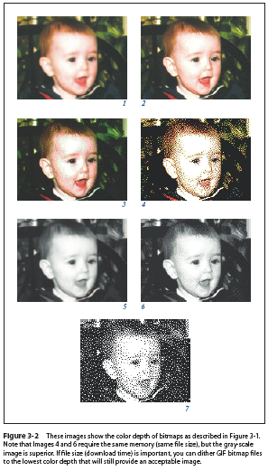
Bitmaps
Figure 3-2 demonstrates various color depths and compression formats.
  Image 1 is 24 bits deep (millions of colors);
  Image 2 is dithered to 8 bits using an adaptive palette (the best 256 colors to represent the image);
  Image 3 is also dithered to 8 bits, but uses the Macintosh system palette (an optimized standard mix of 256 colors).
  Image 4 is dithered to 4 bits (any 16 colors);
  Image 5 is dithered to 8-bit gray-scale (256 shades of gray);
  Image 6 is dithered to 4-bit gray-scale (16 shades of gray);
  and Image 7 is dithered to 1 bit (two colors—in this case, black and white).

Slide 16
Bitmaps
Bitmaps can be inserted by:
  Using clip art galleries.
  Using bitmap software.
  Capturing and editing images.
  Scanning images.

Slide 17
Using Clip Art Galleries
A clip art gallery is an assortment of graphics, photographs, sound, and video.
Clip arts are a popular alternative for users who do not want to create their own images.
Clip arts are available on CD-ROMs and on the Internet.

Slide 18
Capturing and Editing Images
Image editing programs enable the user to:
  Enhance and make composite images.
  Alter and distort images.
  Add and delete elements.
  Morph (manipulate still images to create animated transformations).

Slide 19
Scanning Images
Users can scan images from conventional sources and make necessary alterations and manipulations.

Slide 20
Vector-Drawn Graphics
Most multimedia authoring systems provide for use of vector-drawn objects such as lines, rectangles, ovals, polygons, complex drawings created from those objects, and text.

Slide 21
Vector-Drawn Graphics
Applications of vector-drawn images.
How vector-drawn images work?
Vector-drawn images v/s bitmaps.

Slide 22
Applications of Vector-Drawn Images
Vector-drawn images are used in the following areas:
  Computer-aided design (CAD) programs.
  Graphic artists designing for the print media.
  3-D animation programs.
  Applications requiring drawing of graphic shapes.

Slide 23
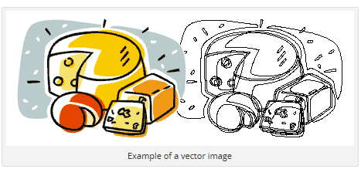
How Vector-Drawn Images Work
A vector is a line that is described by the location of its two endpoints.
Vector drawing makes use of Cartesian co-ordinates.
Cartesian coordinates are numbers that describe a point in two or three-dimensional space as the intersection of X, Y, and Z axis.

Slide 24
Vector-Drawn Images vs Bitmaps
Vector images use less memory space and have a smaller file size as compared to bitmaps.
For the Web, pages that use vector graphics in plug-ins download faster, and when used for animation, draw faster than bitmaps.

Slide 25
Vector-Drawn Images vs Bitmaps
Vector images cannot be used for photorealistic images.
Vector images require a plug-in for Web-based display.
Bitmaps are not easily scalable and resizable.
Bitmaps can be converted to vector images using autotracing.

Slide 26
3-D Drawing and Rendering
Drawing in perspective or in 3-D on a two-dimensional surface takes special skill and talent. Creating objects in three dimensions on a computer screen can be difficult for designers comfortable with squares, circles, and other x (width) and y (height) geometries on a two-dimensional screen.

Slide 27
Features of a 3-D Application
Modeling - Placing all the elements into 3-D space.
Extrusion - The shape of a plane surface extends some distance.
Lathing - A profile of the shape is rotated around a defined axis.
Rendering - Use of intricate algorithms to apply user-specified effects.

Slide 28
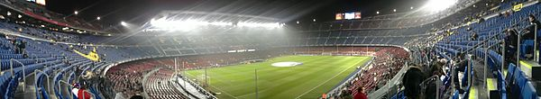
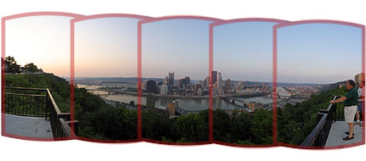

Panoramas
Panoramic images are created by stitching together a sequence of photos around a circle and adjusting them into a single seamless bitmap.
360° panorama of the Te Awamutu Rose Gardens (New Zealand).
The left edge of the photo matches with the right edge, creating a (nearly) prefect transition when seen in a panoramic viewer.

Slide 29
Colors and Palettes in Multimedia
Understanding natural light and color.
Color palettes.

Slide 30
Colors and Palettes in Multimedia
Color is a vital component of multimedia.
Management of color is both a subjective and a technical exercise. Picking the right colors and combinations of colors for your project can involve many tries until you feel the result is right.

Slide 31
Understanding Natural Light and Color
Light comes from an atom where an electron passes from a higher to a lower energy level.
Each atom produces uniquely specific colors.
Color is the frequency of a light wave within the narrow band of the electromagnetic spectrum, to which the human eye responds.

Slide 32
Computerized Color
Because the eye’s receptors are sensitive to red, green, and blue light, by adjusting combinations of these three colors, the eye and brain will interpolate the combinations of colors in between.
the eye and brain will interpolate the combinations of colors in between. This is the psychology, not the physics, of color: what you perceive as orange on a computer monitor is a combination of two frequencies of green and red light, not the actual spectral frequency you see when you look at that namesake fruit, an orange, in sunlight.

Slide 33
Computerized Color
Additive color.
Subtractive color.
Monitor-specific color.
Color models.

Slide 34
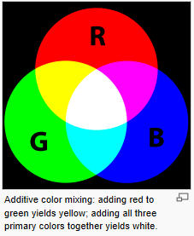
Computerized Color
Additive color.
  In the additive color method, a color is created by combining colored light sources in three primary colors - red, green, and blue (RGB).
  This is used for cathode ray tube (CRT), liquid crystal (LCD), and plasma displays.

Slide 35
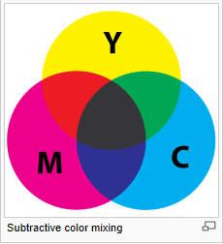
Computerized Color
Subtractive color.
  In the subtractive color method, color is created by combining colored media such as paints or ink.
  The colored media absorb (or subtract) some parts of the color spectrum of light and reflect the others back to the eye.

Slide 36
Computerized Color
Subtractive color.
  Subtractive color is the process used to create color in printing.
  The printed page consists of tiny halftone dots of three primary colors- cyan, magenta, and yellow (CMY).

Slide 37
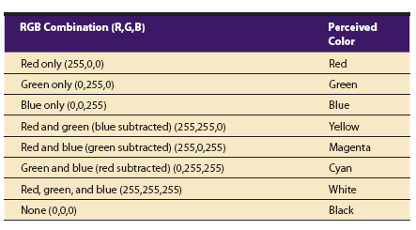
Computerized Color
Subtractive color.
  The following chart shows the three primary additive colors and how, when one of the primary colors is subtracted from this RGB mix, the subtractive primary color is perceived.

Slide 38
Computerized Color
Computer Color Models or Monitor-specific color
Models used to specify color in computer terms are:
  RGB model - A 24-bit methodology where color is specified in terms of red, green, and blue values ranging from 0 to 255.
  HSB (hue, saturation, brightness) and HSL (hue, saturation, lightness) models – Color is specified as an angle from 0 to 360 degrees on a color wheel.

Slide 39
Color Palettes
Palettes are mathematical tables that define the color of pixels displayed on the screen.
The most common palettes are 1, 4, 8, 16, and 24-bit deep.

Slide 40
Color Palettes
Dithering:
  Dithering is a process whereby the color value of each pixel is changed to the closest matching color value in the target palette.
  This is done using a mathematical algorithm.

Slide 41
Image File Formats
Windows Formats
  The most commonly used image file format on Windows is DIB.
  DIB stands for Device-independent bitmaps.
  The preferred file type for multimedia developers in Windows is Resource Interchange File Format (RIFF).

Slide 42
Image File Formats
Bitmap formats used most often by Windows developers are:
  BMP - A Windows bitmap file.
  TIFF - Extensively used in DTP packages.

Slide 43
Summary
The computer generates still images as bitmaps and vector-drawn images.
Images can be incorporated in multimedia using clip arts, bitmap software, or by capturing, editing, or scanning images.
Creating 3-D images involves modeling, extruding, lathing, shading, and rendering.
Color is one of the most vital components of multimedia.

